Slide 2
How to support a loved as they MOVE through recovery Brian Cook, Ph.D. V.P of Movement, Research, and Outcomes

Slide 3
Outline
Understanding exercise
What Does a Healthy Relationship With Exercise Look Like?
A Primer on Exercise and Eating Pathology
How Exercise Relates to Eating Disorder Risks
Understanding the “why” helps us with our approach to exercise
Concrete ways you can support a loved one
Q & A/ Discussion

Slide 4
Let’s play a game
The next two slides show a healthy and unhealthy relationship with exercise. What differences can you spot?

Slide 5
A healthy relationship with exercise looks like:

Slide 6
An UNhealthy relationship with exercise looks like:

Slide 7
What differences did you notice?
Trick question – They were the same pictures
What does this teach us?
We often focus on the behavior of exercise
Behavior is only part of the story
Or focus on the physical attributes of an exerciser
So many things wrong with this!!!!!
Distinguishing individuals struggling with exercise and/or disordered eating is difficult
Current understanding suggests that psychological factors best distinguish exercise for disordered eating from holistic forms of exercise
There is no dichotomy, the relationship of exercise in health is more fluid
Think of it more as a continuum

Slide 8
Eating Disorders Continuum
TAKE HOME MESSAGES:
Virtually everyone struggles with something that resembles an eating disorder.
Exercise is like any other aspect of an eating disorder. It exists on a continuum. There is no ideal of the “right” amount/intensity/type/etc. of exercise.
All things on this continuum must be in balance for sustained recovery.
Try not to over-focus on one behavior (e.g., exercise).
Rather, talk to your loved one to see how exercise fits into the wide array of things that go into maintaining recovery.

Slide 9
How Can Exercise Be Both Beneficial and Harmful?
TAKE HOME MESSAGES:
Exercise behavior is not the ONLY thing that leads to health benefits.
Over-exercise can trigger biological responses that perpetuate an eating disorder.
Balancing exercise with rest, nutrition, and mental well-being is essential for maintaining recovery.
If exercise is so good for you, how does exercise with an eating disorder cause harm?
Simple answer
Exercise is about much more than behavior.
Nutrition, emotions, rest, etc., play a huge part in the biochemical processes that lead to the benefits of exercise
More technical answer
The same region of the brain that controls eating disorders is also affected by overexercise.
When we overexercise, that area of the brain becomes dysregulated.
The observable results are eating disordered behaviors & thoughts.
Rest, nutrition, and stress management can reset these processes.

Slide 10
Malleable Risk Factors
Physical Well-Being
Improved Body Mass
Cardiovascular Disease
Osteoporosis
Sleep Disturbance
Pain
Psychological Well-Being
Depression
Anxiety
Perceived Stress
Positive Affect
Self-esteem
Body Image
Exercise
Quality of Life
Eating Disorder
Social Well-Being
Social Support
Malleable Protective Factors
Mediating Factor
Pathological Exercise Attitudes
Hausenblas, Cook, Chittester, 2008

Slide 11
Warning Signs of Pathological Exercise
Difficulty concentrating
Physical pain & disconnection with one’s body
Mood changes (e.g., anger depression, & irritability)
Low self-esteem
Negative interpersonal interactions
Weight loss and loss of appetite
Increased heart rate at rest
Decreased sports performance
Fatigue
Prolonged recovery time
Lack of enthusiasm
Frequent illnesses
Difficulty completing usual routines
Decreased school/work performance
Personality changes
Sleep disturbances (difficulty sleeping or sleeping without feeling refreshed)
Amenorrhea
Dizzy spells/fainting
CAUTION!!! These are not definitive signs to diagnose over exercise.

Slide 12
Exercise Pathology Prevalence in Eating Disorders
Eating Disorder Variant | Sedentary or No Pathological Exercise | Pathological Exercise
Anorexia - restricting | 59.7% | 40.3%
Anorexia - purging, no binging | 45.5% | 54.5%
Anorexia - binging & purging | 62.6% | 37.4%
Bulimia – purging | 79.8% | 20.2%
Bulimia – binging, no purging | 76.0% | 24.0%
Lifetime diagnosis of Anorexia & Bulimia | 56.5% | 43.5%
Lifetime diagnosis of Eating Disorder Not Otherwise Specified | 79.2% | 20.8%
TAKE HOME MESSAGES:
Knowing your loved one’s diagnosis and prevalence rate of pathological exercise in that diagnosis can help gauge risk for exercise becoming problematic.
Not all exercise is related to eating disorders!
Shroff et al., (2006). Features associated with excessive exercise in women with eating disorders. International Journal of Eating Disorders, 39(6), 454-61.

Slide 13
What does a healthy relationship with exercise look like?
Hard to tell by behavior
Psychological factors play a huge role
Self-acceptance not perfectionism
Internalization
Honest awareness
Ability to balance all aspects of life
Rest is part of the program!
Not succumbing to fad diets, workout plans, or unsubstantiated “health” advice
Movement that fulfills and refuels, not drains and finds perverse pleasure in emptiness

Slide 14
Key Differences in Exercise
Exercise in individuals with eating disorders, or those at risk for eating disorders, is NOT the same as training
Behaviorally appears the same, but motivation for exercise is VERY different
Exercise that fuels an eating disorder is often driven by irrational or perfectionistic thoughts
Exercise is then used to ease negative emotions that underlie these thoughts
Exercise for holistic well-being is driven by self-acceptance and enjoyment
There is a realistic understanding of ability, limitations, needs for rest, and balance with other aspects of one’s life
The table on the next slide can help guide conversations about these key differences

Slide 15
 | Eating Disorder | Self-Acceptance
Self-Talk | I must/should/have to… | I want/wish/would like to …
Results in | Demoralizing you | Motivating you
Focus | Appearances, external validation, and fear of failure | Self-satisfaction with the process and desire for success
Goals | Strive for impossible goals | Enjoy meeting high standards within reach
Source of Value | What you do | Who you are
Adversity | Leads to defeat/giving up | Temporarily disappointed, then move forward
Failure & Criticism | Devastating | Learn from it
Mistakes | Dwell on them | Learn from them
Competition | Need to be number 1/the best; be better than others | Can live without being the best, especially if you have tried your hardest; be the best you can be
Self-esteem | Win to keep self-esteem | Finishing second or lower is ok
Rooted in | Irrational beliefs/fantasy | Rationality/reality

Slide 16
TAKE HOME POINTS
Most people struggle with eating and exercise behaviors
Not all have diagnosable disorders
Behavior may suggest a problem, but DOES NOT diagnose a problem
Eating and exercise disorders are psychological disorders with behavioral presentations
Behavior is only one of many parts of the story
Understanding why behavior occurs and how it relates to pathology is essential
What is driving the behavior?
Understand the “WHY” of exercise and disordered eating
Talk with your loved one and learn what they are going through.
How is exercise related to what they are experiencing?

Slide 17
Ways to Support Your Loved One With Regard to Movement and Exercise

Slide 18
Recommendations for Families and Supportive Others
Create a supportive, healthy, and inclusive environment
Create a holistic, inclusive environment focused on health, not weight
Recognize warning signs
Behavioral, Physical, and Psychological signs
Self reflect on your own beliefs, attitudes, thoughts preferences, and more about exercise
Most of us we raised in a world with potentially dangerous exercise messages (e.g., NO PAIN, NO GAIN)
How are we displaying those messages through our own relationship with movement or exercise?
How would a person with an eating disorder interpret and act on those messages?

Slide 19
If You Suspect Exercise is a Problem
Explain why you are concerned with their exercise behavior
Listen!!!!!
Be prepared for denial and resistance that exercise is a problem
Loved one is likely to only focus only on the benefits of exercise
Show humility in your own understanding of exercise, health, recovery and eating disorders
No one has nor should have all the answers - This is a process
Be patient and supportive
Set a positive example – this may mean challenging your own exercise beliefs and behaviors
Get rid of fitness trackers
They are the wrong tool for the job. What they track is not what is related to sustaining recovery!
An eating disorder specific tracker is included at the end of this slide deck

Slide 20
Questions to Help Start a Discussion
If you wouldn’t burn calories/lose weight/change your shape, would you still exercise?
Why or why not?
What were you feeling before, during, and after you exercised?
What did you give up to do this exercise?
Time to heal/rest/recover
Focus on school/work
Relationships that suffered
Can you journal on your exercise sessions?
Focus on tracking emotions, experiences, connections instead of frequency, intensity, and duration
Use the form at the end of this slide deck

Slide 21
Encourage your loved one to
Spend some quiet and quality time listening to their mind, heart, and body
Respond to that self-understanding and approach exercise accordingly
Respect their inner needs and internal messages
Is their body telling them they need rest?
Respect and respond to their body, especially those messages of pain and fatigue
Examine their motives for exercise
Adjust exercise frequency, duration, intensity, and type as needed
Reserve and make sacred the time they need to take care of themselves without exercise being a part of this selfcare
Find exercise and physical activities which are enjoyable

Slide 22
General Exercise Advice
Exercise because you want to – not because you feel that you have to.
Do exercise activities that you enjoy – not exercises that you dislike.
Include a variety of exercise activities – don’t get in the rut of doing only one or two things.
Include leisure recreation activities such as bike riding or hiking.
Stop if it hurts! Do not exercise when your body is in pain, or when fatigued.
Never exercise with an injury.
When your body is telling you something – listen!
Get some physical activity every day, even if it is just walking around the block.
Drink plenty of water during exercise and afterwards.
Eat enough to properly fuel your body for the rigors of daily life and exercise.

Slide 23
Finding joy in exercise is possible when looking through a “whole person” lens!
Nutrition
Movement
Relational
Medical
Therapy
Movement is an expression
We connect with our self & others
Movement may help with this

Slide 24
THANK YOU!!! Questions, Answers, & Discussion

Slide 25
Tracking Movement
Tracking progress with movement is about understanding which aspects to monitor
In ED recovery, emotions, connections, and rest are more important than traditional fitness metrics like frequency, intensity, and duration
Clients can use the following tracking tool to help identify how movement is related to their eating disorder and recovery (see instructions here, form on next slide)

Slide 26
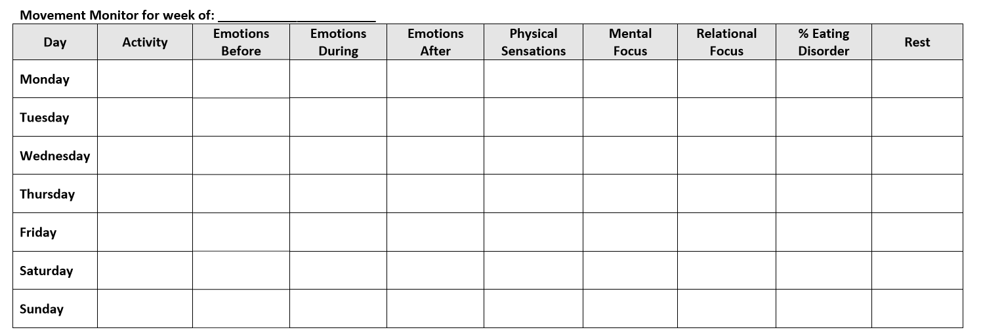

Slide 27
Books on Over Exercise
The Truth About Exercise Addiction
The Exercise Balance: What's Too Much, What's Too Little, and What's Just Right for You!
Diary of an Exercise Addict
Eating Disorders in Sports

