Slide 2
Nutrition in Recovery
Tammy Beasley, RDN, CEDRD-S, CSSD, LD
Vice President of Clinical Nutrition Services

Slide 3
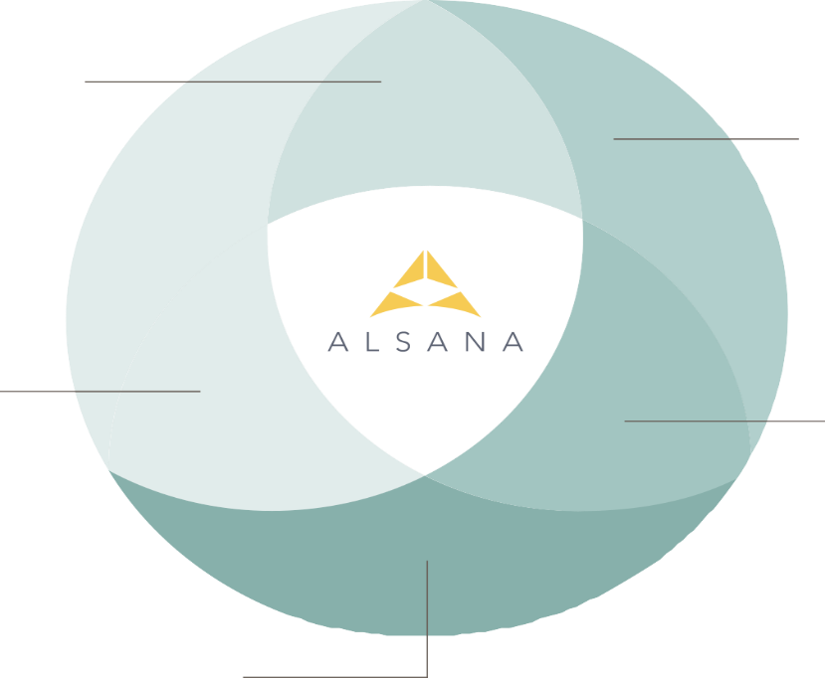
Whole-Person Nutrition Approach
Nutrition-integrated Healing
Heals, Restores, Supports, Fuels
Medical treatment:
Nutrition heals the physical body, the gut-brain connection and hunger/fullness signals
Therapeutic treatment:
Nutrition restores the brain’s communication system and supports its ability to re-wire
Nutrition:
Heals, Restores, Supports, Fuels
Balances nourishment and pleasure through an all-foods-fit approach without shame or judgment
Relational healing:
Nutrition supports connections to self and others, to food and body, and to purpose and hope
Movement Integration:
Nutrition fuels movement and enjoyable active living

Slide 4
What Will We Accomplish Today? Learning and Reflecting on:
The philosophy and principles of the Alsana Nutrition Dimension
The language (and reasons behind it!) of the Alsana Dietitian
The science within the recovery process
The hope of full recovery

Slide 6
The Progression of Acceptance
Distrust
Neutrality
Acceptance
“Our bodies are not nearly as judgmental of our food choices as we are…”
…Jessica-Lauren Newby,
MS, RDN, CEDRD

Slide 7
Our Nutrition Program:
Balances both nourishment and pleasure from food
On a physical and emotional level
From and through the meal experience itself
To restore trust in both food and body without judgment
Uses an “all foods fit” philosophy without good/bad food lists
Teaches balance in portions without using exchanges or measuring tools

Slide 8
Our Nutrition Program:
Provide two individual nutrition sessions every week at RTC
Provide one individual session and a check-in every week at PHP
Provide RD support at meal outings and program meals/snacks
Model collaboration as both RD and therapist co-lead nutrition psychoeducation and ED process groups
Offer three meal challenges weekly in all levels of care
Client creation
Chef or RD’s choice
Family style
Update outpatient RD/team weekly to build bridge for transitions

Slide 9
HUNGER/FULLNESS-BASED MEAL PATTERN
Offer 4 to 6 eating opportunities daily with no more than 3 to 4 hours between eating
Individualize client meal plans based on recovery goals
Comparison triggers can be used therapeutically
Timing of meals/snacks are in the same range for all
Staff modeling of normalized relationship with food

Slide 10
MOVE TOWARD FUEL GROUPS FOR MEALS/SNACKS
Meals and snacks are built from fuel groups
Meals = 3-4 fuel groups + foundation fat
Snacks = 1-2 fuel groups
Simple snack:1 fuel group
Combination snack: 2 fuel groups
Combination 1.5 and 2.0: 2+ fuel groups in larger volume
Meals (and some snacks) include foundation fat
“Add-ons” for higher energy needs
*Names may change, but concepts will remain the same

Slide 11
PRACTICAL PORTION GUIDELINES
Baseball = “real world” visual
Use as guideline for carbohydrate fuel (grains/cereals, starches, fruits, vegetables, plant proteins, desserts), soft dairy proteins (yogurt, cottage cheese), and combination fuel (casseroles, lasagna, etc.)
Ping pong ball = “real world” visual
Use as guideline for fats, cheeses, nuts/nut butters, mayo, dressings, etc.
Palm of hand = “real world” visual
Use as guideline for protein portions
Varies w/ gender, bone structure

Slide 12
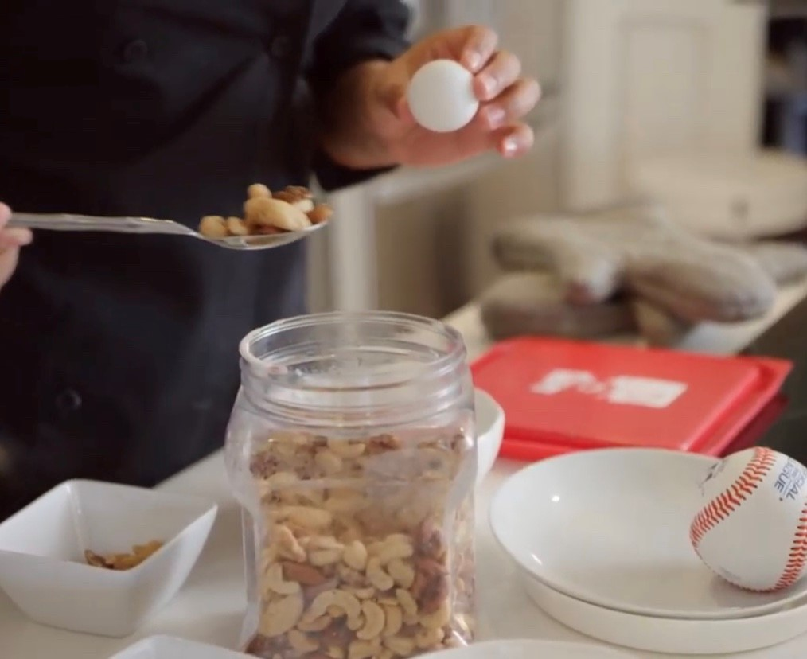
REAL-LIFE VISUAL TOOLS:
Portion Practice
The BASEBALL
The PING PONG BALL

Slide 13
PROGRESSION OF PORTIONING
Staff-portioning
Staff may use measuring utensils to plate food and sample plates
Out of view of clients
Self-portioning
Sample plate for meals
Visual references for guidance (BB, PPB, palm of hand)
Staff-supported portioning feedback
Practice “imperfection”
Challenge ED beliefs
Reduce shame
Independent Self-portioning
Lower levels of care

Slide 14
THREE MEAL PLANNING CHECKPOINTS
Does my meal provide enough fuel groups and foundation fat?
Does my meal provide adequate portions to support my nutrition needs?
Are my portions “normal” and realistic?

Slide 15
PROGRESS OVER PERFECTION
Meal checkpoints challenge client to embrace normal, realistic plans
Client learns to “sit” with “imperfection” using three simple visual portion guidelines
“Imperfect” guidelines encourage trust in body’s ability to balance fuel from day to day
Reflects balance found in other body processes, such as fluids, immune system, and hormonal cycles

Slide 16
Our Focus in Every Interaction
Guide client to see the eating disorder behaviors through:
A filter for shame reduction
A lens of self-compassion
A frame of hope

Slide 17
The Role of the Alsana RD
Neutralize the language with “safe” terminology
Fuel vs. food
Energy vs. calories
Movement vs. exercise
“What is my body telling me?”
Change the interpretation with creative analogies
Translates science into real-world understanding
Builds foundation for compassion and curiosity

Slide 18
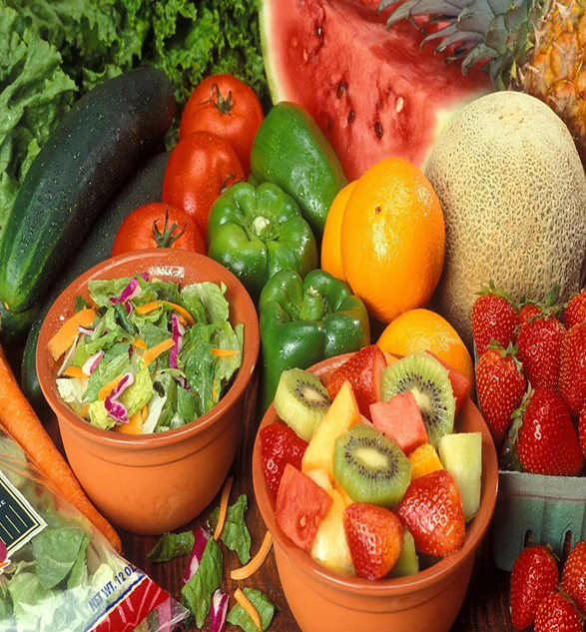
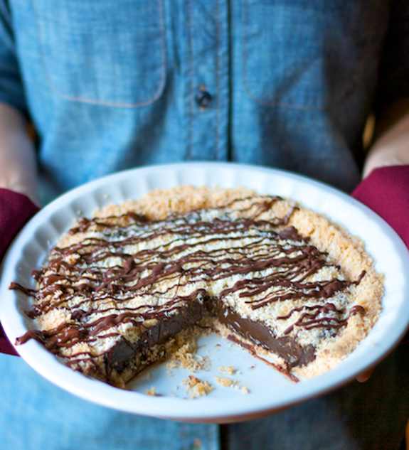
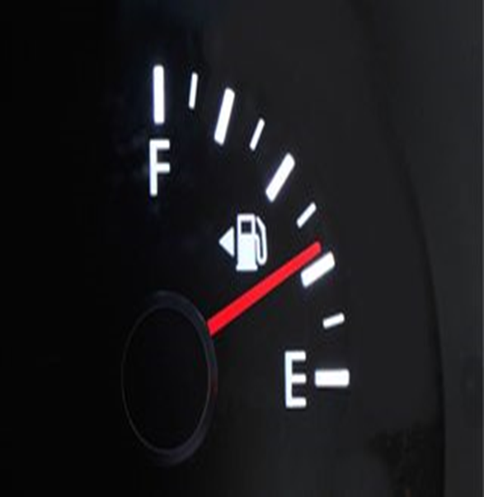
Language Matters: Food or Fuel

Slide 19
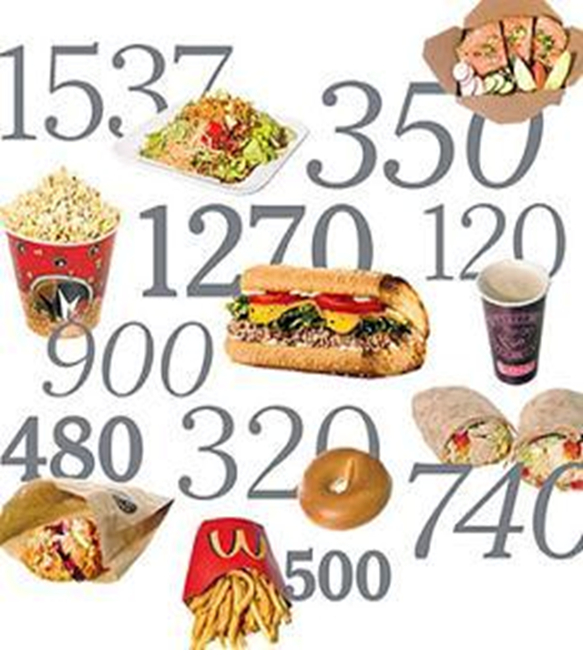
Language Matters: Calories or Energy

Slide 20
Language Matters: “What is My Body Telling Me?”
Focuses on how the body has helped vs. harmed
Reconnects and validates a relationship with body and food
Neutralizes “blame and shame”
Demystifies physical changes during recovery

Slide 21
Nutrition Rehabilitation and Anorexia Nervosa
Metabolic rate decreases 20 – 36%
Body develops a priority list, emphasizing vital activities first
Brain itself needs about 400-500 calories, glucose only
Body compensates by giving up non-life-threatening functions
(Ex: menstruation, digestive enzymes)
Cells learn to perform their jobs without burning as many calories
Weight restoration patterns in recovery
Large variability in # of calories required
Three stages of weight restoration
1st Stage: Initial resistance to weight change
2nd Stage: Comparatively rapid weight change
3rd Stage: Stabilized natural weight

Slide 22
Creative Counseling Strategy: Freezer vs Matchstick
This Photo by Unknown Author is licensed under CC BY-NC-SA
This Photo by Unknown Author is licensed under CC BY

Slide 23
Nutrition Rehabilitation and Anorexia Nervosa
Distribution of weight gain during recovery
Initial: Body gains weight in areas that protect vital organs (stomach, butt, back, trunk)
Intermediate: Body gains weight in places that are not necessary for survival (legs/arms)
Final: Continued weight gain is more gradual and proportionately distributed over entire body
“What is my body telling me?”

Slide 24
Nutrition Rehabilitation and Anorexia Nervosa
Hunger in normal brain
Hunger increases sensitivity to reward in general
Hunger increases activation in immediate reward circuitry specifically
Satiety increases activation in cognitive control circuitry during decision making
Hunger in starved brain
Hunger does not motivate an anorexic brain to eat
No differences in brain response in both reward and cognitive control circuitry during hunger OR satiety in an anorexic brain
Wierenga CE, et al. Biological Psychiatry. Apr 1, 2015; 77:642-652.

Slide 25
The Brain’s Communication System: The Insula
The Insula’s Job:
Manages the internal state of our bodies
Reads body states like hunger and cravings
“Lights up” in brain scans when body craves, feels, chooses, anticipates, etc.
This Photo by Unknown Author is licensed under CC BY-SA

Slide 26
What Does Malnutrition Do?
The brain and gut lose both structure and function
Blood flow to brain (insula) decreases, reducing energy and oxygen
Neurons cannot send messages quickly or consistently
Notes:
Blood flow is directly related to how quickly information is processed by brain. Blood carries energy and oxygen to the brain; that energy and oxygen are what fuel the neurons’ ability to fire messages, such as “I’m hungry”, “I’m full”. Slower blood flow = less energy and oxygen = slower AND inconsistent “internet” connections.

Slide 27
In Summary: A Malnourished Brain…
Cannot process thoughts clearly
Alters self-perception
Increases anxiety, irritability and mood swings
Blunts (and loses) hunger and fullness signals
Monopolizes energy consumed as life-protection measure
Client perception: “My body is the enemy, and I can’t trust it”
Body’s perception: “I’m trying to help you, not harm you”

Slide 28
The Body’s Second Brain, the GUT, is Also Malnourished…
Brain and gut lose ability to produce and maintain healthy serotonin levels
Increases anxiety and depression
Reduces sleep quality and quantity
Mehler PS, Birmingham LC, Crow SJ, Jahraus JP. Medical complications of eating disorders. In: The Treatment of Eating Disorders: A Clinical Handbook. 2010
Variety of gut flora is severely altered
Compromises immune system
Reduces fluid secretion
Slows gut motility
Gastroparesis, or delayed gastric emptying, develops
Bloating from gas and distention after eating
Pain can be severe

Slide 29
So How Do We Translate These Brain/Gut Changes?

Slide 30
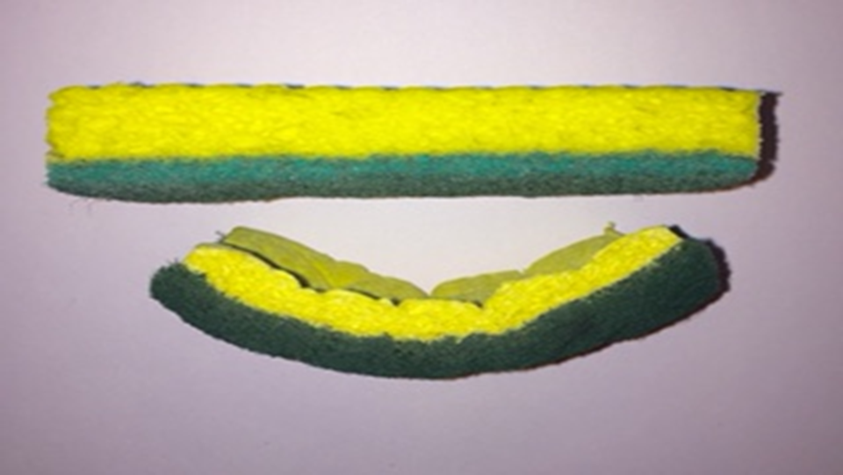
Nutrition Psychoeducation: Translating Science through Creative Analogies

Slide 31
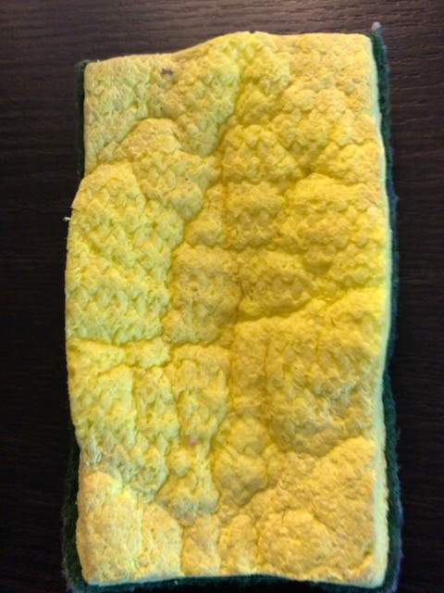
The Sponge “Distortion” over Time

Slide 32
Nutrition Rehabilitation and Bulimia Nervosa
Body has learned to release large amounts of anti-diuretic hormone to manage purging
During 1st 6 weeks, body continues to release extra anti-diuretic hormone as protection
Causes body to retain extra fluid after being chronically dehydrated (What is my body telling me?)
Retains extra fluid weight in face, ankles, skin, fingers, abdomen, inner thigh
During this time, it is important to resist the urge to restrict fluids or over-exercise
Body will return to its natural weight within 2 to 3 months
Fluid normalization may be delayed if/when client returns to purging

Slide 33
Creative Counseling Strategy: The Hiker and Body Trust
This Photo by Unknown Author is licensed under CC BY-NC

Slide 34
Nutrition Rehabilitation and Bulimia Nervosa
Insulin regulation is progressively imbalanced
Body adapts to high sugar “binge” diet by producing large amounts of insulin just after eating
Increases appetite
Promotes body fat storage
Consuming “normal” meal does not produce “fullness”, reduce cravings or satisfy urges
Insulin-produced hypoglycemia, a protective learned response
“White knuckle” intensity surrounding hunger/cravings
Body needs time to re-calibrate the insulin/blood sugar relationship with normal eating

Slide 35
Creative Counseling Strategy: Survive the Riptide

Slide 36
Brain Reward Circuitry and Binge Eating
Nutrition Rehabilitation and Binge Eating
Dopamine hormone is released in response to “pleasure” signals (food)
Dopamine circuits are associated w/ reward
Brain will automate response to behavior if repeated often
“Want” it but do not have to “like” it

Slide 37
If Brain can Predict Reward, It Responds to the Dopamine Trigger
This Photo by Unknown Author is licensed under CC BY-NC-ND
Notes:
Food-laden environments and even pictures of food can trigger dopamine release

Slide 38
Brain Reward Circuitry and Binge Eating
Evidence suggests brain reward circuitry is more active with sugar-based foods in hungry subjects vs. satiated subjects
Evidence suggests that dopamine reward responses from “acute food pleasure” adjust over time; more required for same effect

Slide 39
Cortisol Feeds the Problem…
Stress triggers cortisol release
Cortisol looks for stored glucose to “feed” stress
Increases release of glucose from liver to blood
Decreases storage of glucose from blood to liver
Triggers release of more insulin which can cravings

Slide 40
Flood Gate: Repetition Through Permission
Permission embracing curiosity and “imperfection” reduces emotional flooding
Repetition of meal timing and fuel balance without emotional flooding strengthens brain connection
Repeating the new connection rewires the brain through the repetition itself

Slide 41
Validate Your Loved One’s Experience with COMPASSION and CURIOSITY:
Acknowledge that “this process is hard, and I can see that you are trying and having a difficult time”.
Validate “emotional fullness” as real, and yet guide loved one to see that emotional fullness and physical fullness are not the same thing.
“Your body’s hunger/fullness signals are still healing”
“This is a normal part of recovery and takes time”
“Since your body is still healing, it needs more fuel today to support recovery”
Ask, “What are the messages right now from your eating disorder? What are the messages right now from RECOVERY?”
Ask, “Do you feel that this portion will support your recovery today? or your eating disorder?”

Slide 42
Space… to Breath and Think
What CAN we do?
Call out the emotions for what they are – simply recognizing them w/o judgment helps switch gears
Focus attention on smaller shifts in behavior and thought patterns
Remember the flood gates
Picture riding out the blood glucose rip tide

Slide 43
Space… and TIME
What CAN we do?
Practice separating the self-blame from the thought itself
Recognize the self-blame
“I’m disgusting!”
Add SPACE to separate emotion and thought
“I’m having a THOUGHT that I’m disgusting”
Patience in the practicing
Patience from the practicing
Invest TIME
Keep a HOPE JOURNAL
Recognize any small changes

