Slide 1


Maintaining Recovery:
How to/Ways to Find Connections Outside your ED Network
Courtney J. Yergin - MSSA, LICSW, LISW-S
Lead Therapist RTC Jemison
Huntsville, AL

Slide 2



Agenda
Introductions & Check In
Back in the ‘Real World’
Build, Buoy, Boost Boundaries
Core Values & Beliefs
Questions

Slide 3




Introduction
Howdy! Who’s out there? Tell me about yourself:
  Name, Pronouns, Location
  What did your body do this week that you’re grateful for?
  What are you most looking forward to next week?

Slide 4

Back to The Real World
“To find out what happens…and start getting real” (TM)
Struggles, Surprises, and Stamina in Recovery

Slide 5


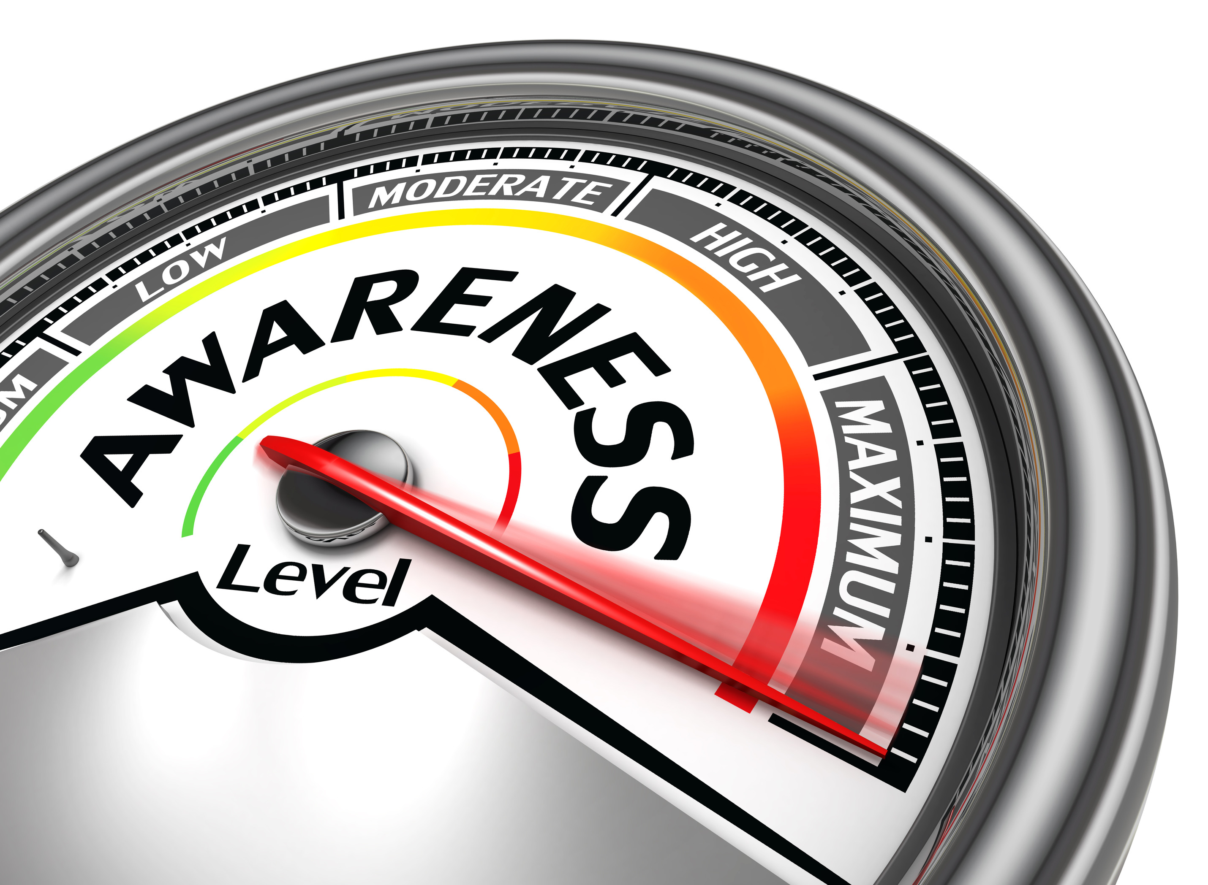




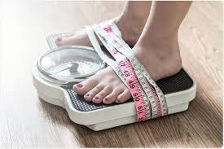




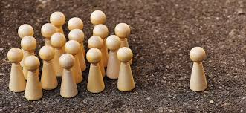

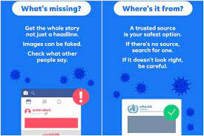

Slide 6

Confronting & Healing
Stigma
Stigma From Within - Lack of self-esteem and self worth
Stigma From The Recovery Community
Stigma From Treatment Providers
Stigma From the Outside - Public scrutiny
The ZOOM dance – Tree vs. Forest / You vs. The World

Slide 7

Which is it?
You run your thoughts or your thoughts run you??
https://www.youtube.com/watch?v=S-dhWUqVN_A&t=2s
“Hands as your Thoughts Metaphor”
Acceptance Commitment Therapy (ACT)

Slide 8


BUILD
BUOY
BOOST
BOUNDARIES!

Slide 9
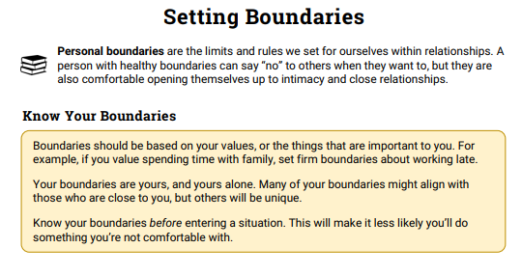
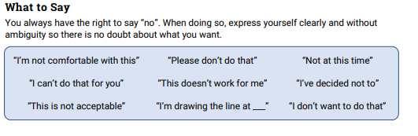

How do you build & maintain YOUR fence?

Slide 10

Core Values
What drives you?
What powers your recovery amidst “the real world?”
What can you be proud of?

Slide 11
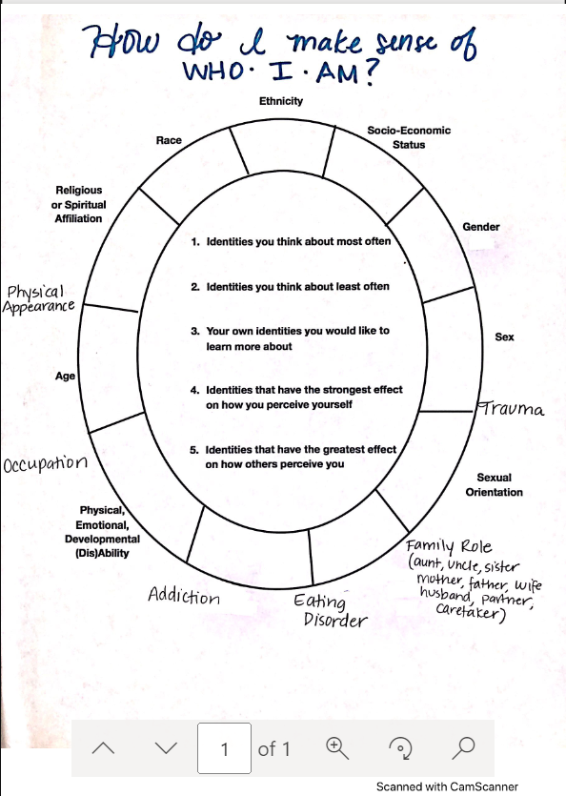


Slide 12


QU'EST-CE QUE C'EST?
Thank You!!
Courtney J. Yergin MSSA, LICSW, LISW-S
courtney.yergin@alsana.com
https://www.alsana.com/huntsville-alabama-residential/

